Slide 1

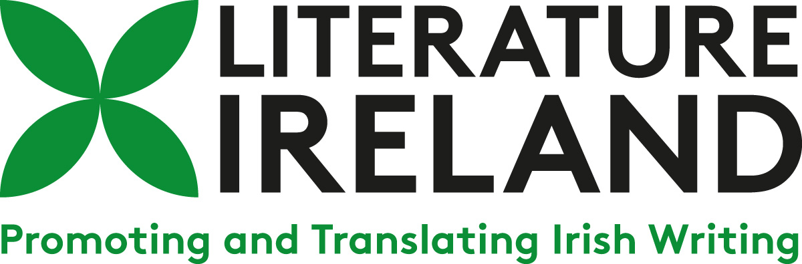
Summer translation workshops
Summer Translation Workshops
28 June – 2 July 2021

Slide 2
Practical Workshops with Practising Literary Translators
Workshops with professional translators for French, german, Italian and spanish
Plenary discussions and readings with irish writers and irish literary experts
Fully online, five-day programme for literary translators & postgraduate students

Slide 3
Workshop tutors
Short bios for the workshop tutors and leaders for each language

Slide 4
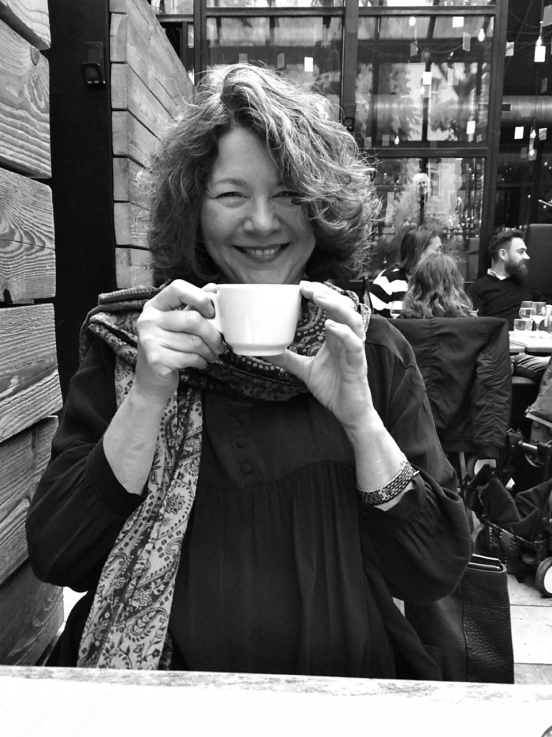
Marie Hermet (French)
Marie Hermet is a literary translator and reader for numerous French publishing houses. She has translated over sixty works from English, primarily literary and young adult titles, including by Irish authors such as Donal Ryan, Roddy Doyle, Dermot Bolger, Helen Falconer, Caitlin Moran and Tom Moore. Marie also teaches translation and creative writing at the Université de Paris, where her curricula have a strong focus on Irish literature.
In 2017, Marie Hermet was the recipient of a Literature Ireland–Trinity College Dublin translator residency. She has also attended workshops on creative writing in Dublin. She recently translated a piece by Adrian Duncan for Literature Ireland’s Talking Translations podcast series.
Marie has received several awards for her work, including the Prix des Mordus du Polar 2014, the Prix Livrentête 2017, the Prix Bermond-Bocquié Festival Atlantide 2017 for Plus froid que le pôle by Roddy Doyle, and the Sélection du prix des Incorruptibles 2021 for N’oublie pas de penser à demain by Siobhan Curham.

Slide 5
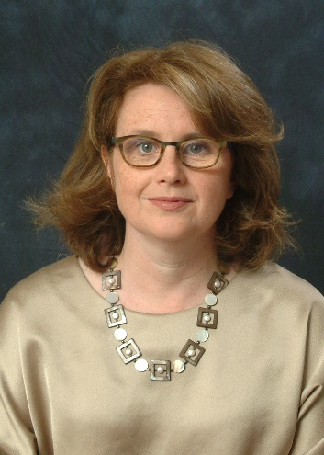
Clíona Ní Ríordáin
(French)
Clíona Ní Ríordáin is a critic, translator and Professor of English at the Sorbonne Nouvelle, where she teaches translation studies and Irish literature. Her most recent book is English Language Poets in University College Cork 1970–1980 (Palgrave Macmillan, 2020).
Clíona translated Michel Déon’s memoir, Horseman, Pass By (Lilliput, 2017). She has also edited three anthologies of Irish poetry; the most recent, Jeune Poésie d’Irlande: Les poètes du Munster (Illador, 2015), was co-edited and co-translated with Paul Bensimon. The duo will publish a volume of Gerry Murphy’s poems, Plus loin encore, with Circe this autumn.
Clíona Ní Ríordáin chairs the Fondation irlandaise’s Translation Prize and sits on the Strategic Committee of the Centre Culturel Irlandais.

Slide 6
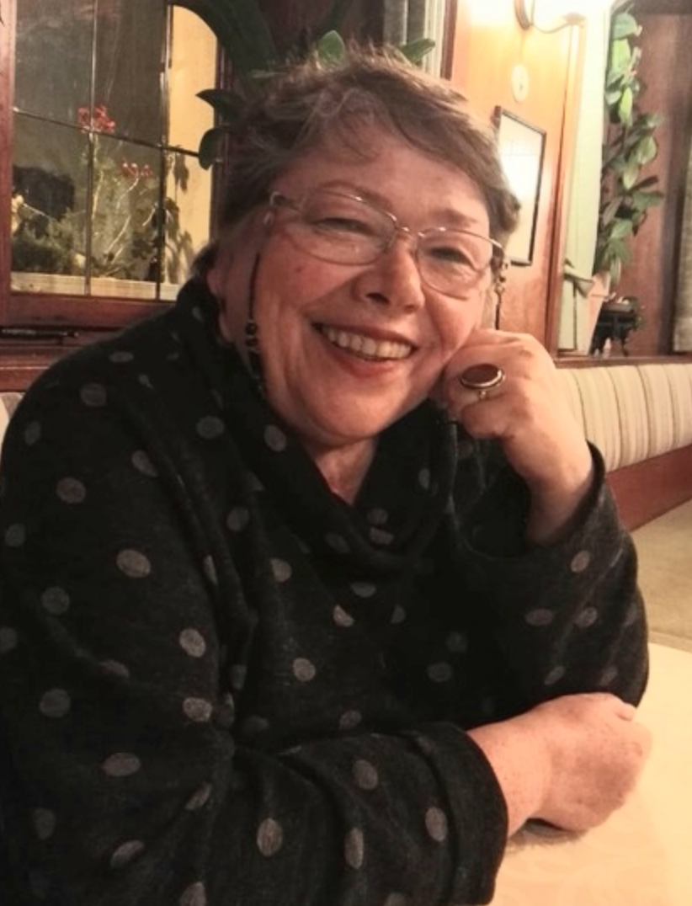
Christa Schuenke
(German)
Christa Schuenke holds a BA in English and French from the University of Leipzig and an MA in Philosophy from Humboldt University, Berlin. She has worked as a freelance literary translator since 1981 and has been teaching and giving workshops and lectures on translation since 1993.
Christa has translated over 180 works of prose, poetry, non-fiction, drama and screenplays throughout her career, including Irish writers John Banville, Paul Lynch, Robert McLiam Wilson, Jonathan Swift and W.B. Yeats, as well as William Shakespeare, John Donne, John Keats, Herman Melville, Edgar Allen Poe, F. Scott Fitzgerald, among many others.
Her awards include working scholarships from the Berliner Senate, the European Commission at EÜK, Straelen, the Deutscher Literaturfonds and the Deutscher Übersetzerfonds. She was awarded the Christoph Martin Wieland Translator’s Prize for a new translation of Shakespeare's sonnets and the Translator’s Prize of the Arts Foundation North Rhine/Westphalia for a new translation of Melville’s novel Pierre. She has been translator-in-residence at Heriot-Watt University in Edinburgh and completed residencies with the BCLT and Literature Ireland.
Christa Schuenke has been vice-president of German PEN and a board member of the German Literary Translators Association (VdÜ).

Slide 7
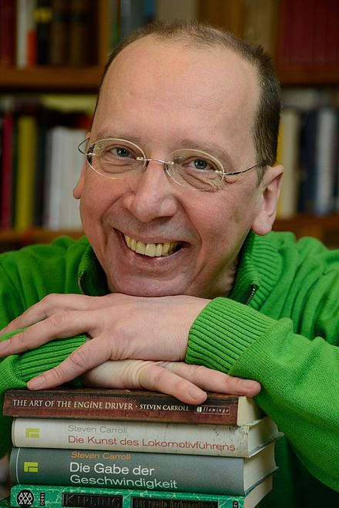
Peter Torberg
(German)
Peter Torberg completed an MA at the Westfälische Wilhelms-Universität Münster and postgraduate studies at the University of Wisconsin, US. He has several years’ experience as a freelance journalist and as an editor with a medical publishing house. His first literary translation of a novel was published in 1984, and since 1990, he has worked full time as a literary translator. He is married with three children.
Peter has translated the Irish writers Adrian McKinty, Conor McPherson and Oscar Wilde, as well as a host of other English-language authors, including Paul Auster, John le Carré, Anita Desai, William Golding, Norman Mailer, Michael Ondaatje, Mark Twain and Irvine Welsh. His awards include a Fulbright Grant (1985), a grant for literary translations (1993) from the city of Munich; grants from the Deutscher Übersetzungsfonds in 2000 and 2007; a grant from the Stiftung Kulturfonds Ahrenshoop 2002; a Barthold Heinrich Brockes grant 2010; and a grant from the Banff International Literary Translation Centre in 2011. He has been awarded the post of Literature Ireland–Trinity College Dublin Translator-in-Residence for 2022.

Slide 8
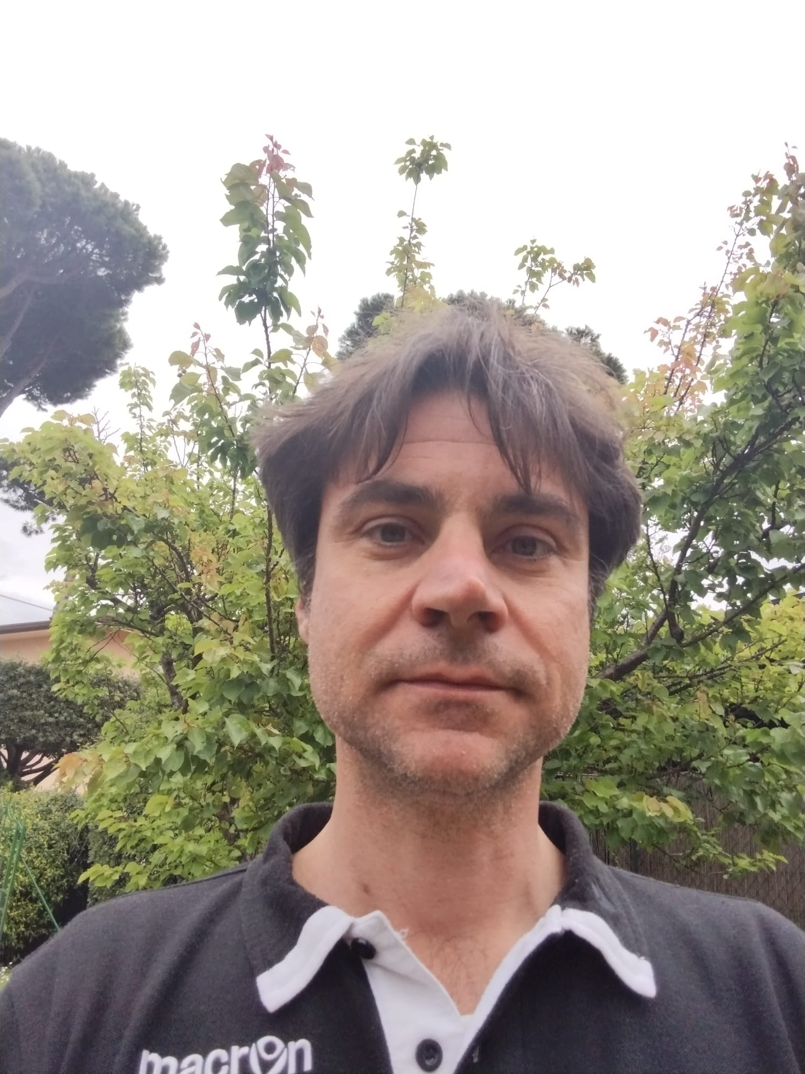
Andrea Binelli
(Italian)
Believe it or not, Andrea Binelli started his career teaching Italian language in Co. Tipperary in the nineties. He subsequently completed a PhD in Modern Foreign Literatures at the University of Pisa in 2004 and is currently professore associato at the University of Trento, where he teaches translation studies and English language and linguistics.
Andrea’s research interests include semiotics, translation theory, corpus linguistics, corpus-based critical discourse analysis, sociolinguistics and Irish English. His main focus is on Irish language, literature and culture and he has published books and essays on the semiotics of space in contemporary Irish writing, the rhetorical and pragmatic parallelisms between interior monologues in Ulysses and today’s communication through Twitter, cultural memory and the social function of mythology in the Irish decolonisation, and the use of supposedly Republican arguments in the same-sex marriage referendum debate.
Andrea Binelli is also a translator, mainly of Irish literature, with both mainstream and independent Italian publishing houses. He has translated novels and short stories by Lady Gregory, George Orwell, Ford Madox Ford, Donal Ryan, Elske Rahill, Patrick McCabe, Andrew Fox and John Kelly. He is a regular contributor to Il manifesto and Alias on Irish topics. He is on the scientific boards of such academic journals as James Joyce Studies in Italy, Ticontre, Between, and Studi irlandesi – A Journal of Irish Studies.

Slide 9
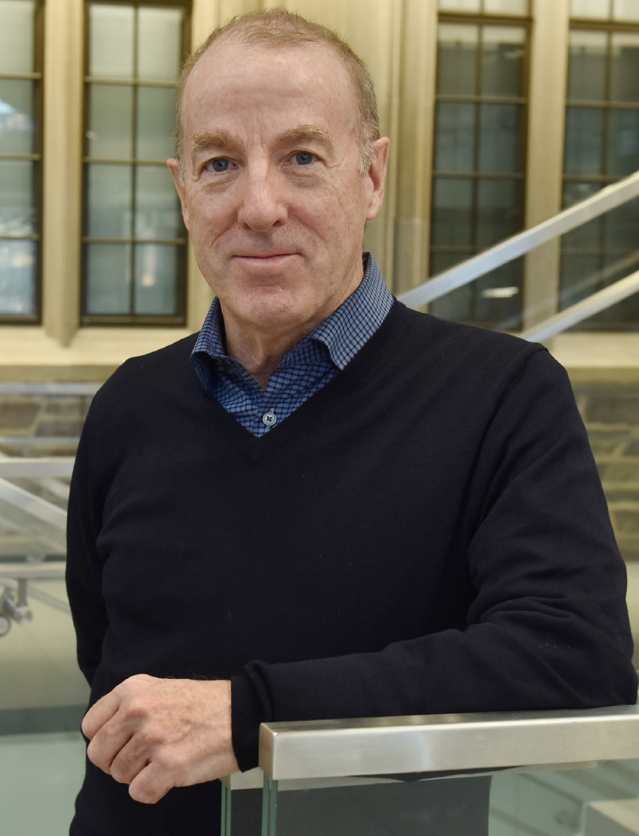
Michael F. Moore
(Italian)
Michael F. Moore is a translator and interpreter from Italian. He recently completed a multi-year project to bring the great Italian novel The Betrothed, by Alessandro Manzoni, into American English (Modern Library, 2022). His published translations include works by Primo Levi, Alberto Moravia, Sandro Veronesi and Fabio Genovesi. He is currently working on a new translation of Moravia’s short story collection Rome Tales. In addition to his works on paper, Michael has also done subtitles for the films Christ Stopped at Eboli, Senso and Il Boom. For over two decades, he worked as an interpreter for the Italian mission to the UN. He has also interpreted for many of Italy’s leading filmmakers and writers when they have presented their works in New York.
Michael F. Moore earned a diploma in sculpture from the Brera Fine Arts Academy in Milan, following which he returned to the US to complete a PhD at New York University on the early editions of Petrarch’s poetry collection Il Canzoniere. The evolution of the Italian literary language continues to be the central focus of his studies and translations. For many years, Michael served as the Chair of the PEN Translation Committee and, subsequently, as the Chair of the Advisory Board of the PEN/Heim Translation Grant. Recognition of his work includes an NEA Translation Grant, the first translator-in-residence at Princeton University, and a residency at the Rockefeller Centre in Bellagio, Italy.

Slide 10
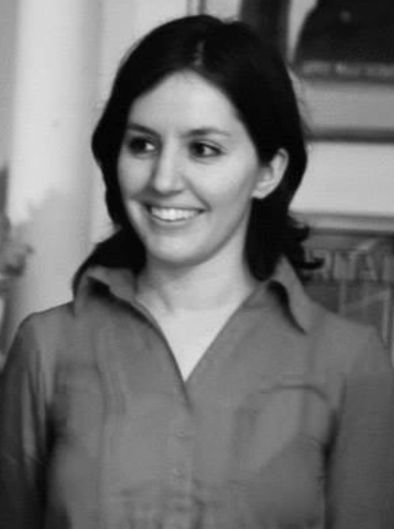
Clara Ministral
(Spanish)
Clara Ministral studied Translation and Comparative Literature and has been translating fiction and non-fiction from English to Spanish for over a decade. She has translated around twenty books, including works by Rebecca Solnit, Jan Carson, Mark Boyle, Colin Bateman, Sherman Alexie, John Haines and Rebecca Miller. During that time, Clara has also held other positions in the arts sector, both in the UK and in Spain, primarily in publishing and bookselling. Since 2018, she has been running a mentoring scheme for emerging translators in Spain in collaboration with the Spanish Association of Literary Translators. Camino de vuelta (The Way Home) by Mark Boyle is her latest published translation.
Clara Ministral is the translator of Jan Carson’s novel The Fire Starters, winner of the 2019 European Union Prize for Literature for Ireland, the translation of which has received support from Literature Ireland. She has also been one of the participating translators in Literature Ireland’s Talking Translations podcast series, working with an extract from Caoilinn’s Hughes The Wild Laughter and on a forthcoming episode on Michelle Gallen’s Big Girl, Small Town.

Slide 11
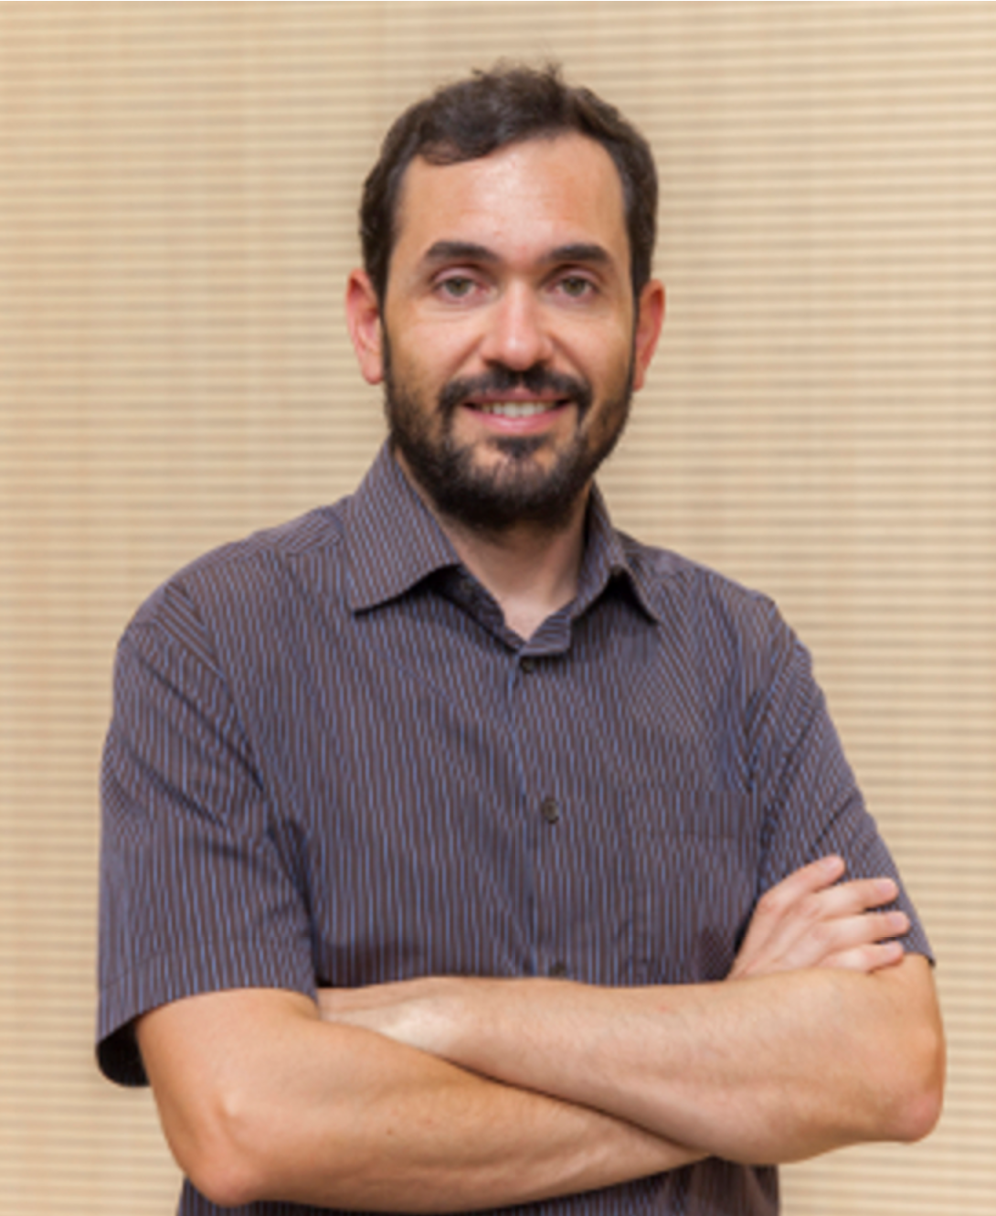
Arturo Peral
(Spanish)
Arturo Peral holds a PhD from Comillas Pontifical University for research on the reception of James Macpherson’s Ossianic poems in Spain. He has worked as a literary translator since 2008 and has been teaching on the translation and interpreting degree course at Comillas Pontifical University since 2009. He previously taught on the MA in Translation course at the Universidad Complutense de Madrid.
Arturo has translated numerous writers from English and French, including Alafair Burke, Tara Isabella Burton, William Joyce, Norman Lewis, Walter Scott and Irvine Welsh.
Since 2020, Arturo has been the Vice-Chair of ACE Tradutores, the Spanish Association of Literary Translators, having previously served as treasurer and vice-secretary between 2009 and 2015. He is also co-director of Vasos Communicantes, ACE Tradutores’ literary translation magazine.

Slide 12
How to apply
Please note that places are limited to max. 12 per course.
The subsidised cost of attendance is €175.
To apply to participate, please email your CV and a one-page letter of intention to workshops@literatureireland.com.

